Slide 1

upGrad Knowledgehut Hackathon Project
- Mohammad Nayab

Slide 2

Project Target:
To build and train a model that identifies a customer will repay or default from the loan dataset.
Tools used:
Jupyter Notebook
Python Libraries : numpy, pandas, scikit-learn, seaborn, matplotlib

Slide 3
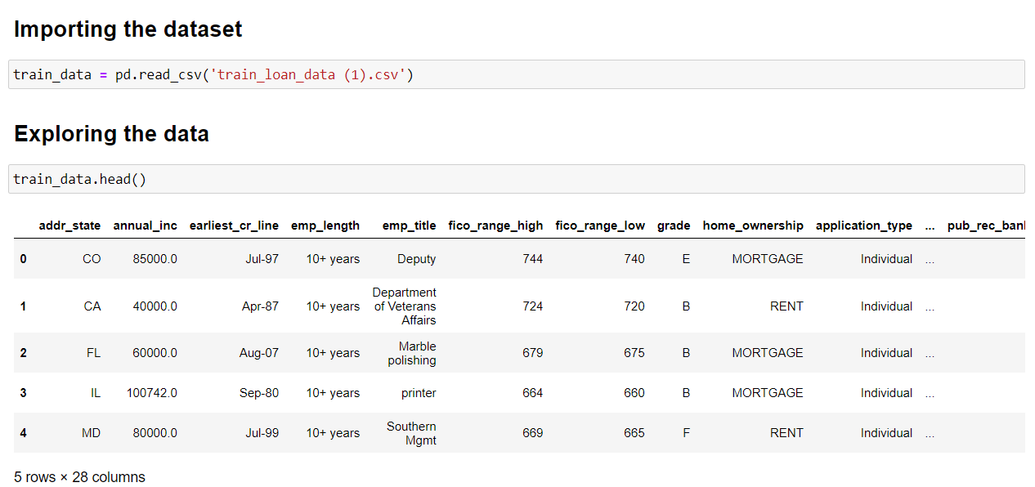

Slide 4
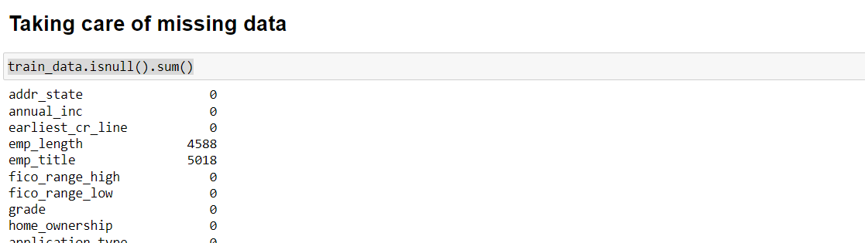
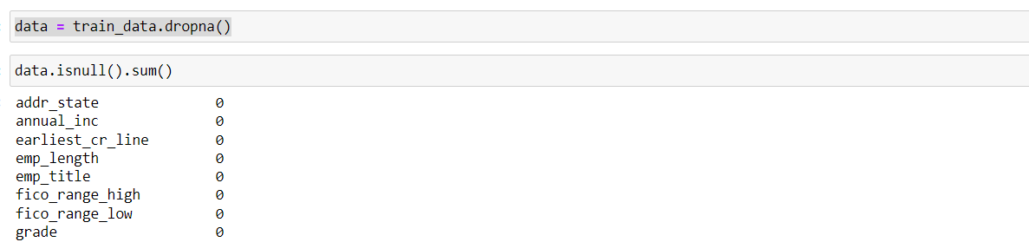

Slide 5
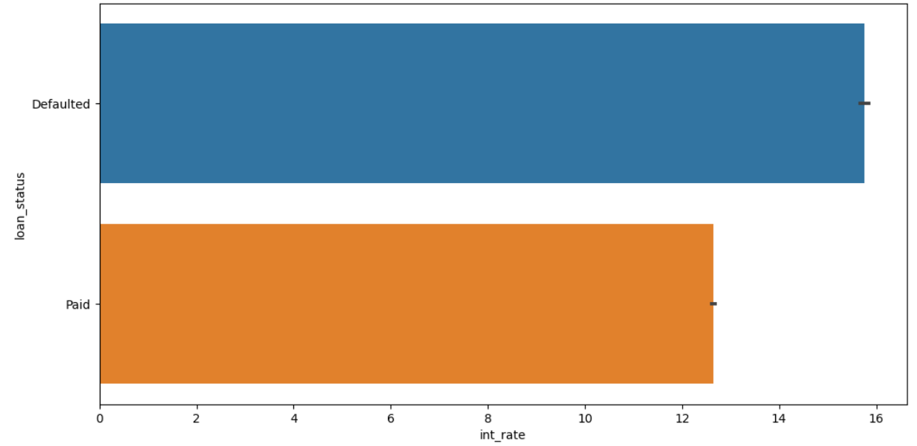

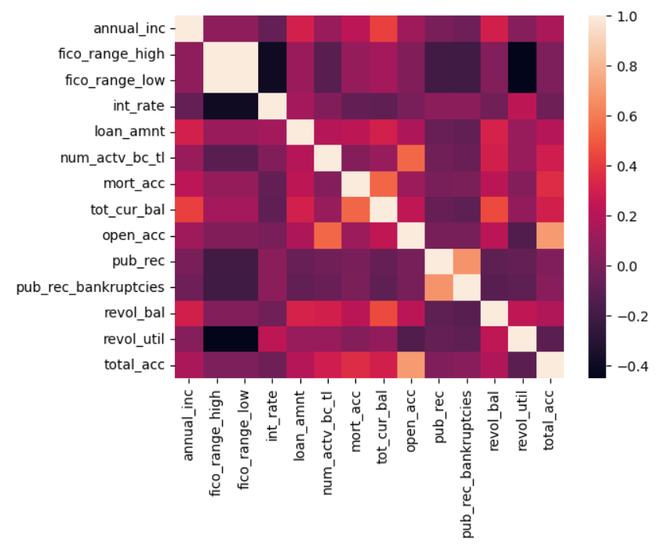
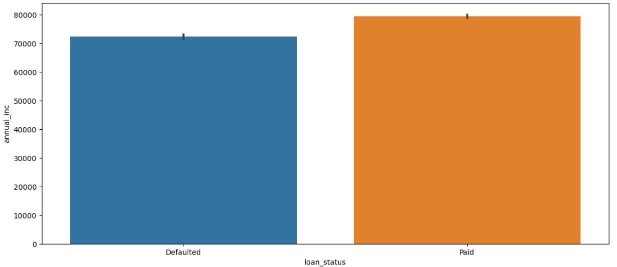

Slide 6
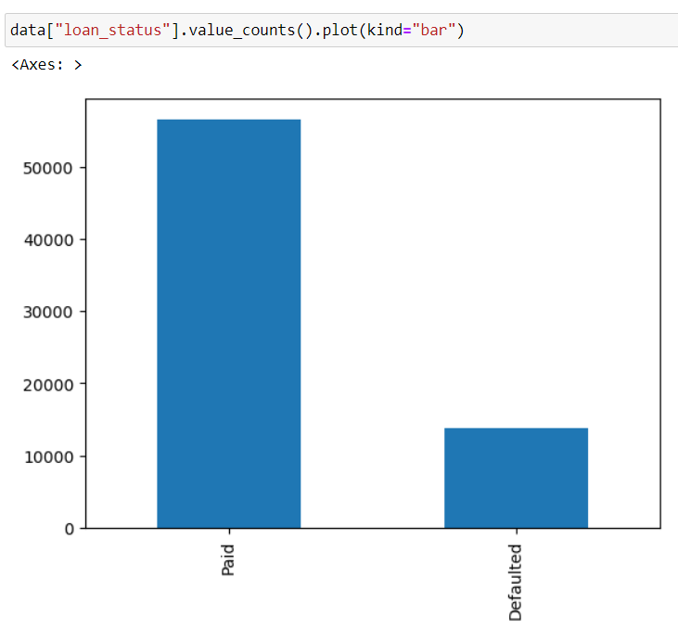
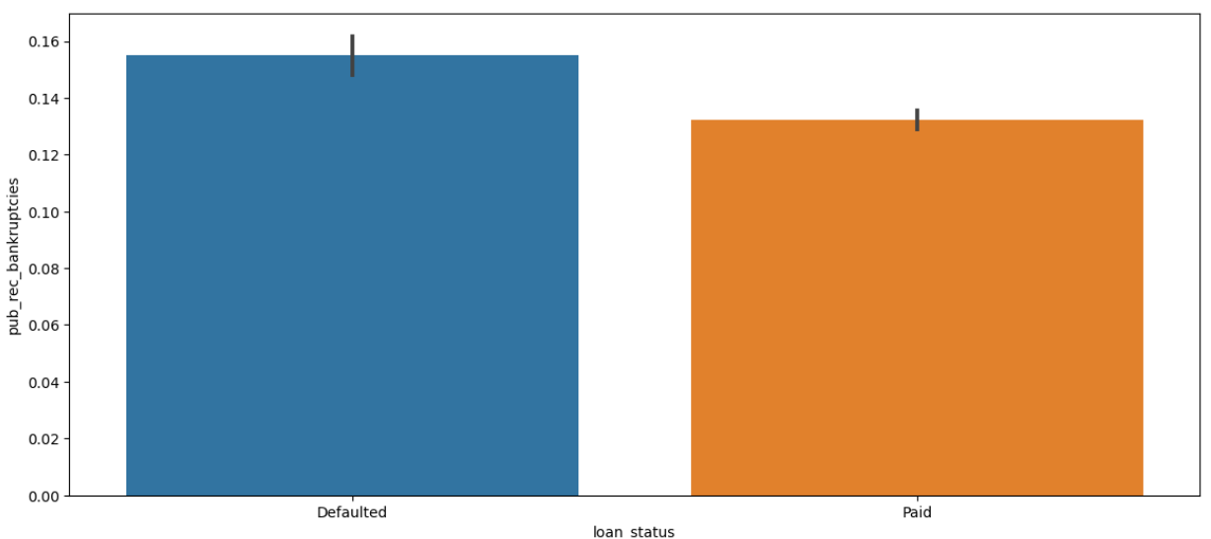

Slide 7
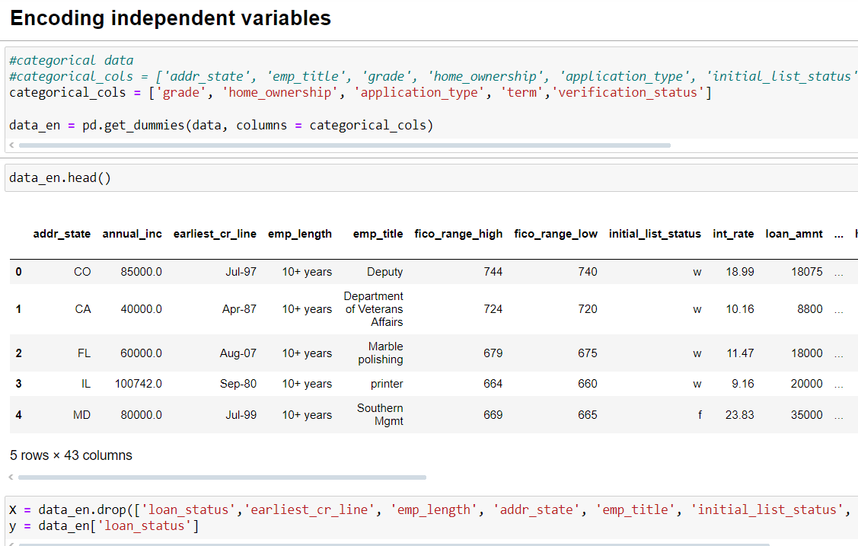

Slide 8
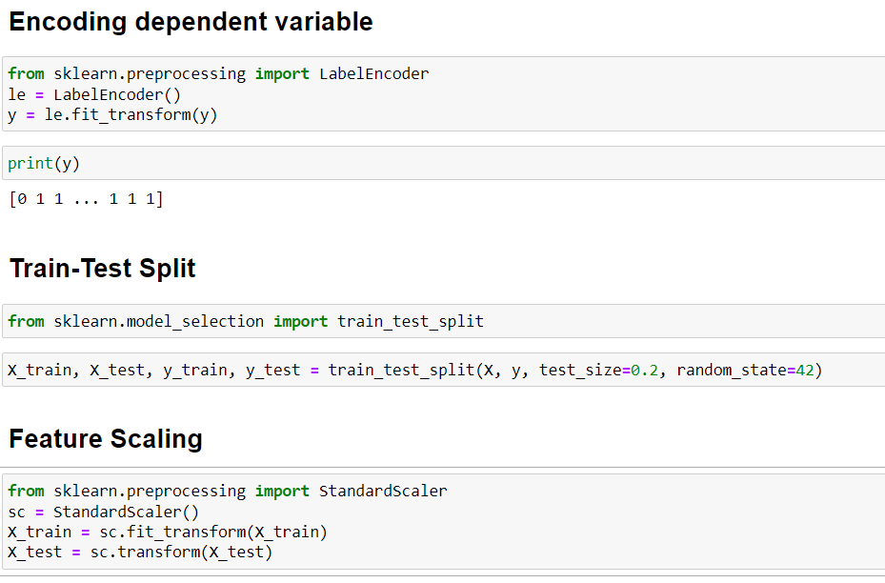

Slide 9
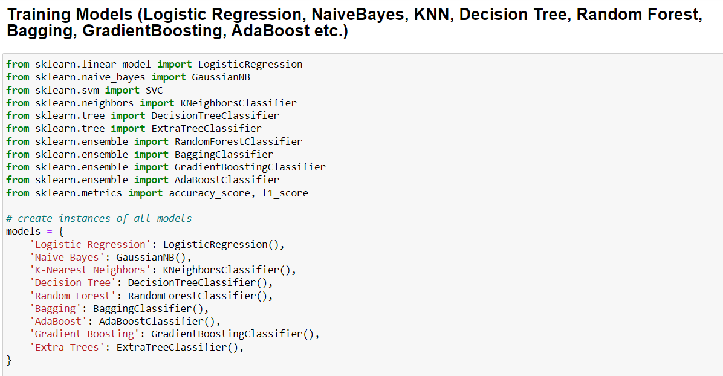

Slide 10
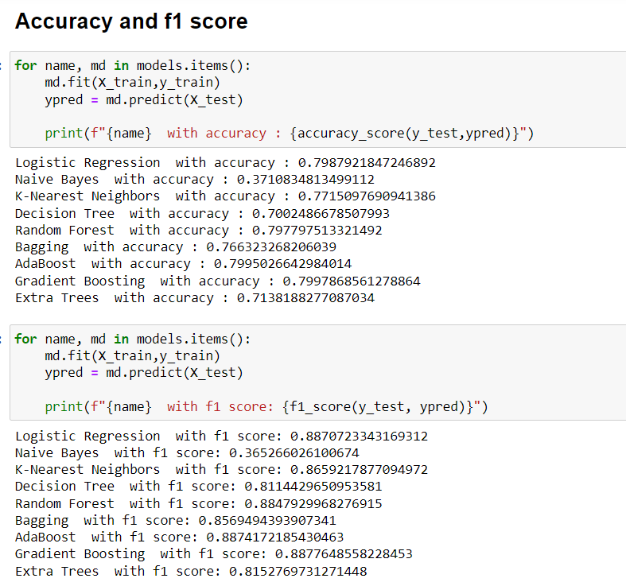
Best Results were gotten by LogicRegression, RandomForest, AdaBoost and GradientBoost models with ~80% accuracy and ~88% f1 score.

Slide 11
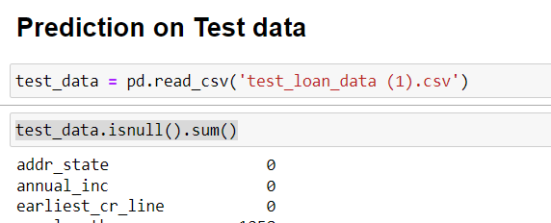
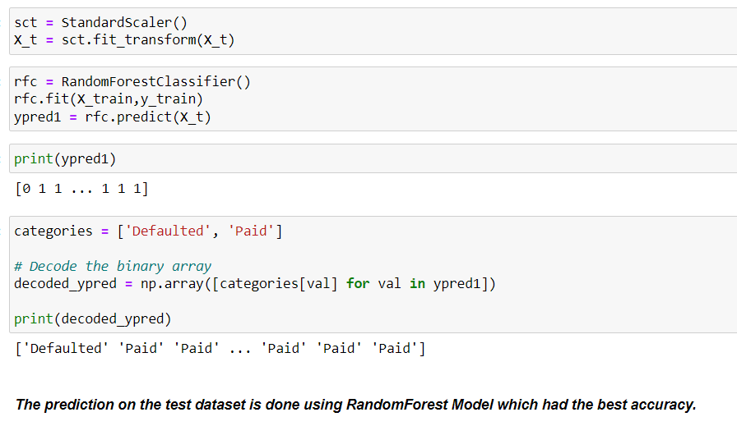

Slide 12

Challenges and Summary:
The dataset was challenging because it has 28 features and multiple of them are categorical data. So, the first important step was feature-selection to choose the important features.
The dataset contained few missing values but it was less than 10% so the rows containing missing values were dropped.
We can see from the data that joint applicants were more likely to default.
People with less annual income (< 70k) were more likely to default.
Longer term loan applicants were more likely to default.
Applicants with higher interest rate tend to default
Credit score of loan applicants was not too effective as they were nearly the same

Slide 13
Thank You!

